Slide 1
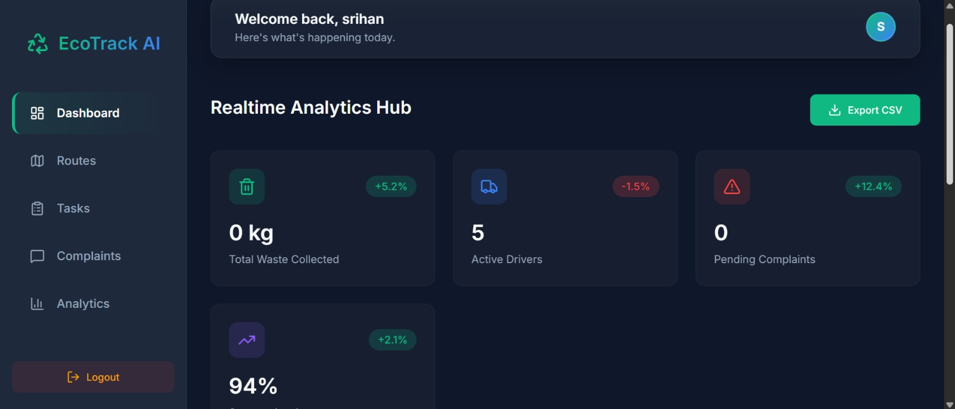
AIAC - AI ASSISTED CODING IN TECHNOLOGY
AI Waste Management App
Student Details
ML Models / AI Scope
- Name: V. Snehitha
- Hall Ticket No: 2303A52331
- Batch: 39
- Course: AIAC - AI Assistant Coding in Technology
- Vision-based waste category prediction using Groq Llama model calls
- AI-assisted driver allocation for route optimization
- Analytics, complaints, tasks, routes, and segregation insights
- Scope: smart municipal waste monitoring and operational decision support
Project Name
AIWaste Management App
Live dashboard preview from the app

Slide 2
Introduction Of Project
Slide 2
Problem Statement
Project Overview
- Manual waste collection and complaint handling are slow, reactive, and difficult to monitor.
- Cities need a smarter way to classify waste, dispatch drivers, and track service quality in one place.
- AIWaste Management App is a web application for smart waste operations.
- It combines analytics, complaint management, task dispatching, driver tracking, and AI-based waste analysis.
- The shared project includes backend APIs, MongoDB models, AI prompts, and a Vite/React frontend structure.
Core Module
Core Module
Core Module
Core Module
AI Waste Analysis
Task Dispatch
Complaint Tracking
Route Support
Accepts image input, predicts category and confidence, then saves the result.
Creates collection tasks with area, priority, location, and driver assignment data.
Citizens can file issues and administrators can update status and replies.
AI grouping plus OSRM routing helps assign trips for active drivers.
Why This Project Matters
- Improves visibility of waste operations through a central dashboard.
- Encourages faster issue resolution through complaint and task workflows.
- Demonstrates practical AI integration inside a full-stack application.
.

Slide 3
Project Objectives
Slide 3
01
Classify waste images with AI and store waste categories for reporting.
02
Digitize waste operations using tasks, routes, complaints, and analytics.
03
Support administrators and drivers with real-time operational visibility.
04
Improve route planning using AI-based allocation and OSRM map routing.
05
Provide a clean front-end experience for login, analytics, and task handling.
06
Show how AI-assisted coding can speed up project development and feature creation.

Slide 4
Stakeholders
Slide 4
Citizens / Users
Administrators
- Log complaints about waste issues
- Track platform activity and service response
- Benefit from cleaner and faster waste handling
- Monitor dashboards and analytics
- Create tasks and manage complaints
- Review collection status and performance
Drivers / Field Staff
Municipal / Project Team
- Receive assignments and route guidance
- Update operational progress
- Manage active loads and upcoming collections
- Uses the system for decision support
- Evaluates AI impact on day-to-day operations
- Maintains the app, database, APIs, and future deployment

Slide 5
Programming Languages, Tools, And Software
Slide 5
Frontend
Backend
AI, Mapping, And Dev Tools
- HTML5 and CSS for layout and styling
- JavaScript / JSX pages in a Vite-style React project structure
- Pages shown in screenshots: Login, Dashboard, Tasks, Analytics
- Node.js with Express.js REST APIs
- Mongoose models for User, Driver, Task, Complaint, and Waste
- mongodb-memory-server used in the shared backend setup
- dotenv and cors configured in the server
- Groq SDK for LLM / vision requests
- Model calls in code: Llama 4 Scout and Llama 3.3 70B
- OpenStreetMap Nominatim for geocoding
- OSRM for route path generation
- VS Code, npm, and AI coding assistant workflow

Slide 6
All Prompts Used To Generate The Codes
Slide 6
Representative AI-assisted coding prompts reconstructed from the delivered project modules and screenshots.
Prompt 1 - Waste Analysis API
Prompt 2 - Driver And Task Management
- Create a backend endpoint that accepts a base64 waste image and weight.
- Call a vision model and return category plus confidence as JSON only.
- Store valid categories such as Organic, Recyclable, Hazardous, and E-Waste.
- Build task creation, driver registration, and status tracking APIs.
- Support collection area, priority, assigned driver, and upcoming collections.
- Return dashboard-friendly JSON for frontend task pages.
Prompt 3 - AI Driver Allocation
Prompt 4 - Frontend Pages
- Add AI logic so the system can allocate tasks to available drivers.
- Group tasks territorially and return assignment mapping in JSON format.
- After allocation, fetch real route paths for each driver.
- Generate dashboards for login, analytics, complaints, routes, and tasks.
- Design a dark UI with KPI cards, charts, side navigation, and forms.
- Make the app feel modern and operationally focused.

Slide 7
Flow Chart Of The Workflow
Slide 7
1. Login / Register
2. Upload / Create
3. API Processing
4. AI / Mapping
User enters the app through secure account screens.
Image upload, complaint filing, or task creation starts the process.
Express routes send requests to controllers and MongoDB models.
Groq prompts analyze waste or allocate drivers; OSRM builds paths.
Operational Data Loop
5. Database Update
6. Dashboard Analytics
7. Action Output
Waste stats, tasks, drivers, and complaints are stored or updated.
KPIs and charts refresh for administrators and users.
Routes, complaint replies, and collection tasks are shown in the UI.
Workflow Summary
- Input enters through UI screens
- Backend validates and processes data
- AI prompts support classification and driver allocation
- Outputs return to analytics, tasks, and route pages

Slide 8
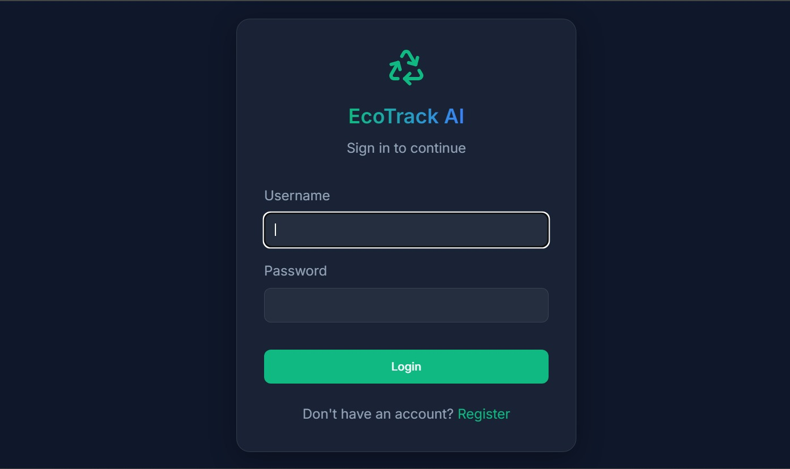
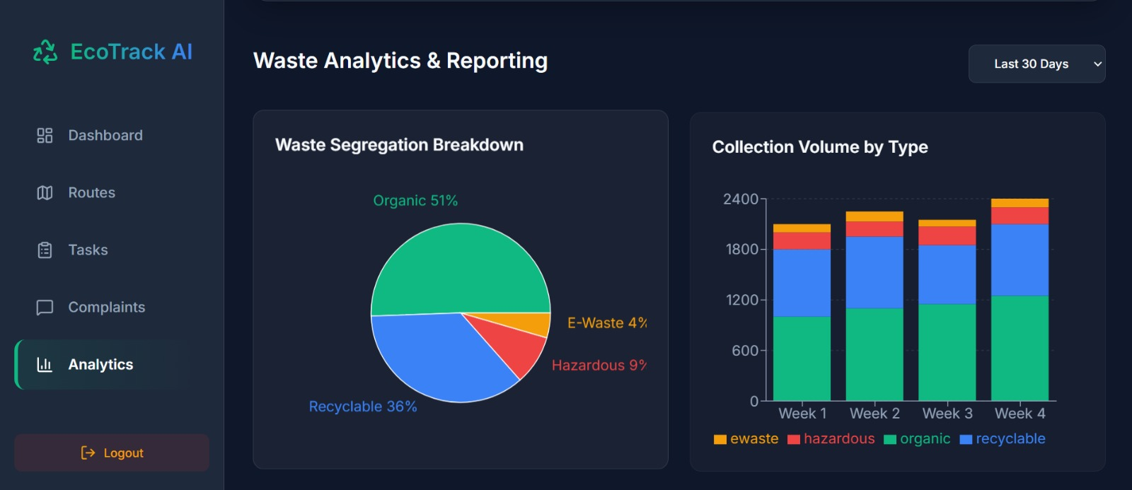
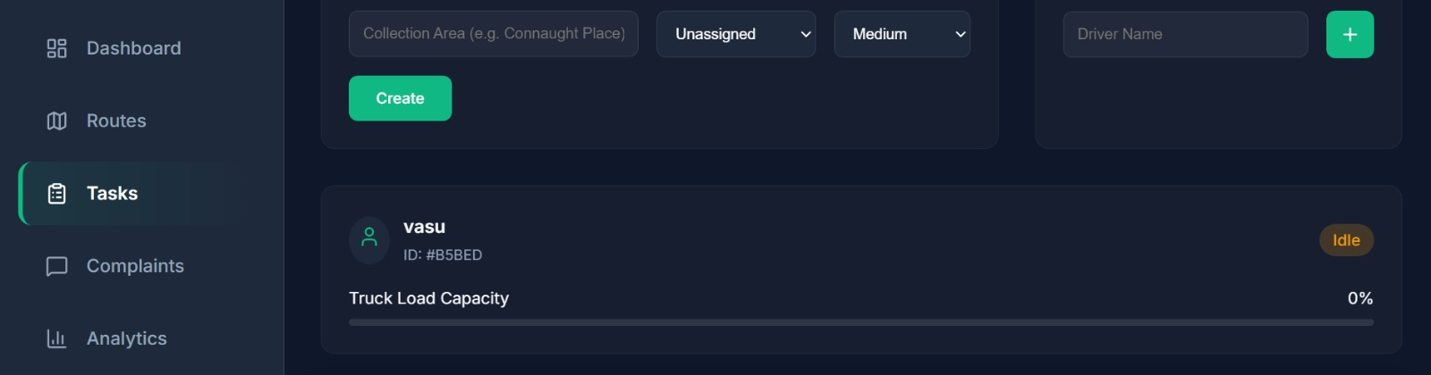
Front-End View Of The Web Application
Slide 8
Actual screenshots supplied for the AIWaste Management App UI.
Login Screen
Dashboard
Analytics Page
Tasks And Driver Registration
Application URL (local demo): http://localhost:5173 | Backend API: http://localhost:5000/api

Slide 9
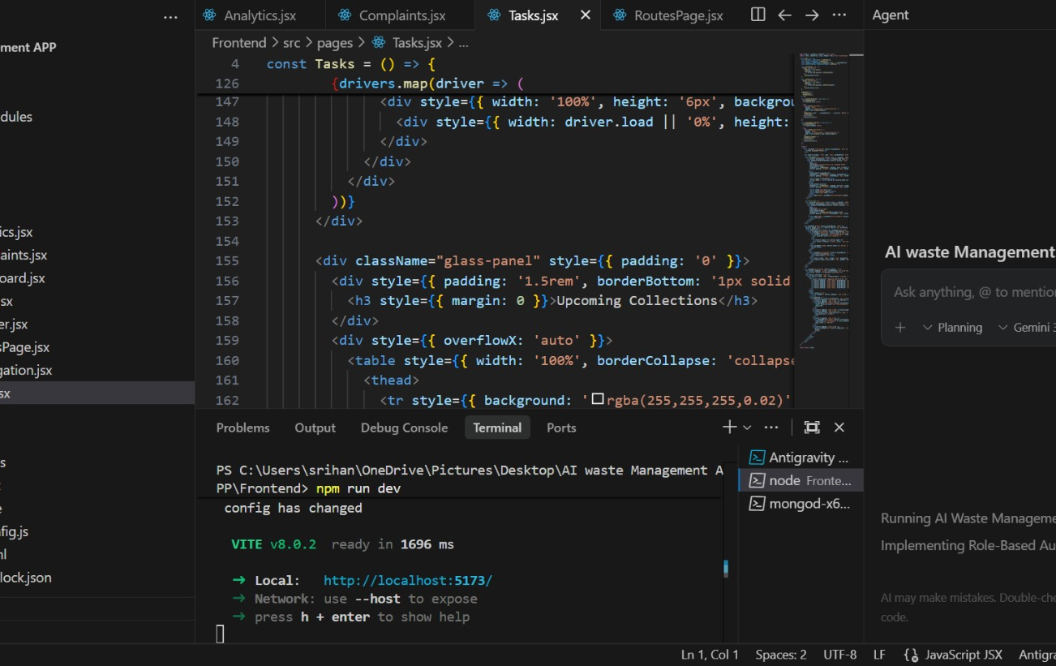
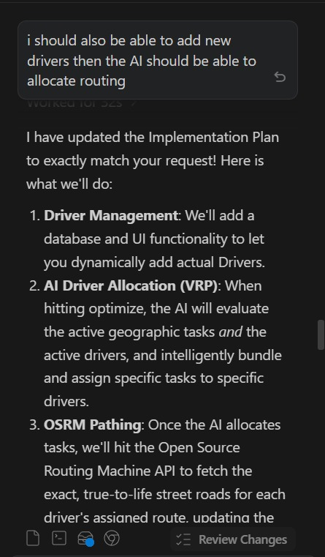
Proof Of Prompts Generating Codes
Slide 9
Proof From Development Screens
- Editor screenshot shows frontend pages such as Analytics.jsx, Complaints.jsx, Tasks.jsx, RoutesPage.jsx, Login.jsx, and Register.jsx.
- Terminal shows Vite local server output and active coding workflow.
- AI assistant screenshot shows prompt-driven implementation planning for driver allocation and OSRM routing.

Slide 10
References
Slide 10
Project References
AI Tools Used
Files Used For This PPT
- Express.js documentation
- Mongoose and MongoDB documentation
- Vite and React frontend structure
- OSRM routing API
- OpenStreetMap Nominatim geocoding
- Groq SDK and supported model calls
- Groq SDK in backend for AI / vision requests
- Llama 4 Scout model call for waste image analysis
- Llama 3.3 70B model call for driver allocation logic
- AI coding assistant workflow shown in the shared screenshots
- AI waste Management APP.zip
- Airport_AIAC_Presentation-2342.pptx
- Website/app screenshots sent in chat
- Frontend and backend source files extracted into the workspace

